Slide 1
Automatic tree farm
Ali Ismail

Slide 2


About me
-Name : Ali Ismail
-Age : 15 years
-location : Lebanon
-age group : 15-18 group
-email : ali.Ismail@rhhs.edu.lb
-goal : goal 13 climate action

Slide 3

The problem
Bush fires have many effects on the climate because of the CO2 defused in the air which is one of the green house gases. When there is a bush fire, green areas burn which mean there is no filtration of the CO2 defused in the air after the bush fire.

Slide 4

The Solution
The solution of such a problem is by replanting the burned areas but the problem is by finding the right amount of tree to fill an area to reduce the CO2 level .

Slide 5

The project idea
My project is a huge scale automatic tree farm, that uses a network of micro bits to control and maintain the trees growth. This farm is always prepared for replanting especially after the bush fires.

Slide 6


How it works design:
It is an indoor vertical farm that plants trees in three layers of the same kind, each layer contain 6 trees. The watering system, temperature and the cameras are controlled by a network of micro bits. Everything is supervised by a human in the control room.

Slide 7
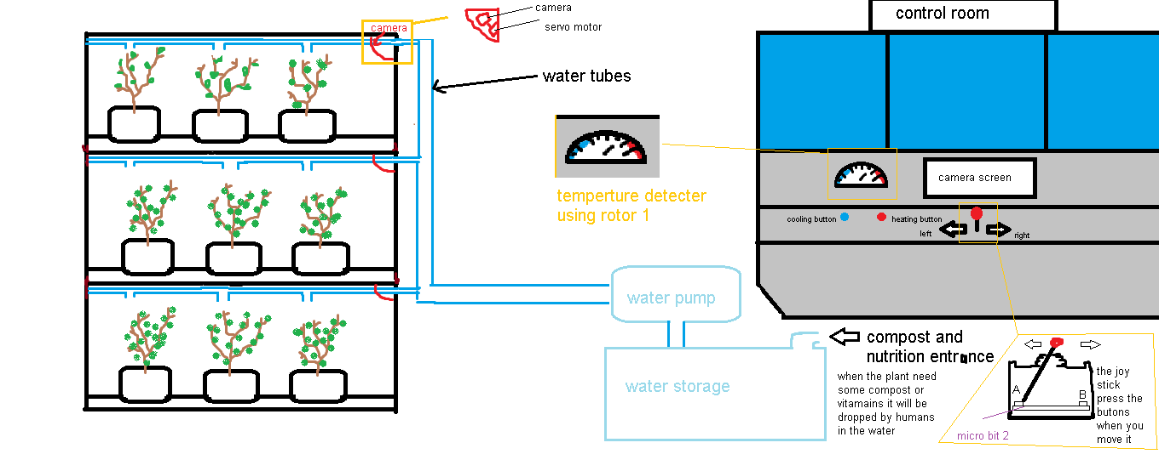

Slide 8
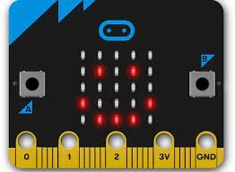
How it works
Micro bit network:
The network is formed of three micro bits (micro bit 1-2-3) for each vertical farm.
-micro bit 1:
Micro bit 1 has the role of tracking the humidity of the soil of one plant (it applies to all other plants since all are of the same kind). When the humidity gets less then 40%, the micro bit sends a message to micro bit 2.
Micro bit 1 measures the temperature and display it using the servo motor 1 in the control room.
-connected to micro bit 2 by radio signals.
-connected to humidity sensor, servo motor 1.
-the temperature sensor inside the micro bit 1.

Slide 9
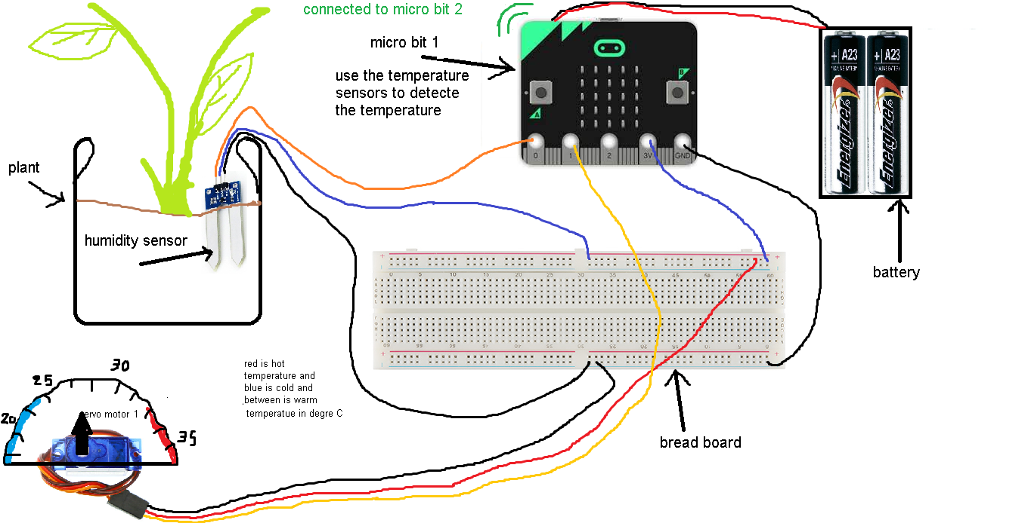

Slide 10

How it works micro bit network
-micro bit 2:
Micro bit 2 is the controller of the camera motors (servo motors 2-3-4 connected to micro bit 3. When button A or B is pressed, micro bit 2 sends a message to micro bit 3.
Micro bit 2 receives the message from micro bit 1and turn on the water pump for 15 seconds.
-connected to micro bit 1-3 through radio signals.
-connected to a water pump.

Slide 11
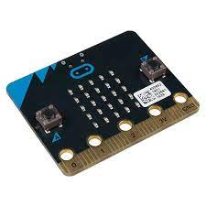
How it works micro bit network
-micro bit 3:
Micro bit 3 receives messages from micro bit 2. Depending on the message, it turns the three servos either to the right direction or to the left direction.
-connected to micro bit 2 by radio.
-connected to servo motors 2-3-4.

Slide 12
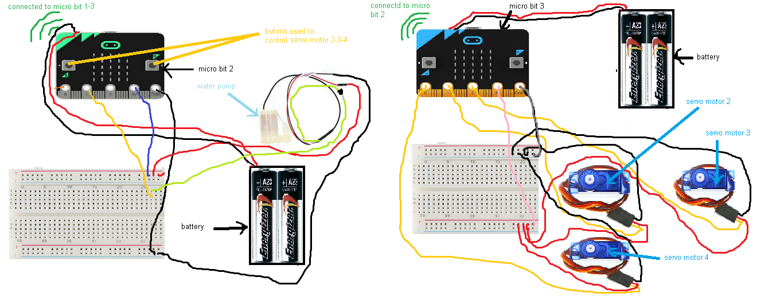

Slide 13
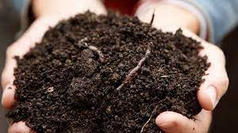
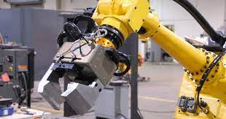
Future updates
- Automatic feeding system that controls feeding of the plants and measures the vitamins and the nutrition level in the soil.
- Huge controlled Grabber to get the trees of three layers and is placed on the ground so it can plant in the replanting areas

Slide 14


